Slide 1

ITIL® 4 Foundation Certification Course
Lesson 4: ITIL® Service Value System
Based on AXELOS ITIL® material.
ITIL® is a [registered] trade mark of AXELOS Limited.

Slide 2


Learning Objectives
By the end of this lesson, you will be able to:
Describe the ITIL service value system
Identify the interconnected nature of the service value chain and how opportunity and demand trigger activities within the ITIL SVS
Outline the nature, use, and interaction of the guiding principles
Elaborate on the role and position of governance in the ITIL SVS
Understand the continual improvement model

Slide 3



The ITIL® Service Value System
Topic 1: Introduction to Service Value System

Slide 4
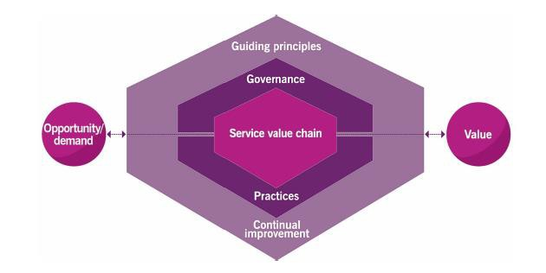
Service Value System Overview
The ITIL SVS describes how all the components and activities of the organization work together as a system to enable value creation.
The components, activities, and organization’s resources can be configured in multiple combinations.
It requires the coordination of activities, practices,
teams, authorities, and responsibilities.
Figure 4.1 The ITIL service value system

Slide 5
The ITIL® Service Value System
Topic 2: Opportunity, Demand, and Value

Slide 6
Opportunity and Demand
Key inputs
Options to add value for stakeholders to improve the organization
Desire for products and services among internal and external consumers

Slide 7
Value
Outcome of the SVS is value

Slide 8
Opportunity, Demand, and Value
Opportunities can trigger work within the system even when there is no demand.
Organizations should prioritize new or changed services with opportunities for improvement to ensure their resources are correctly allocated.
Opportunity and demand trigger activities within the ITIL SVS that lead to value creation.

Slide 9
The ITIL® Service Value System
Topic 3: The ITIL® Guiding Principles

Slide 10
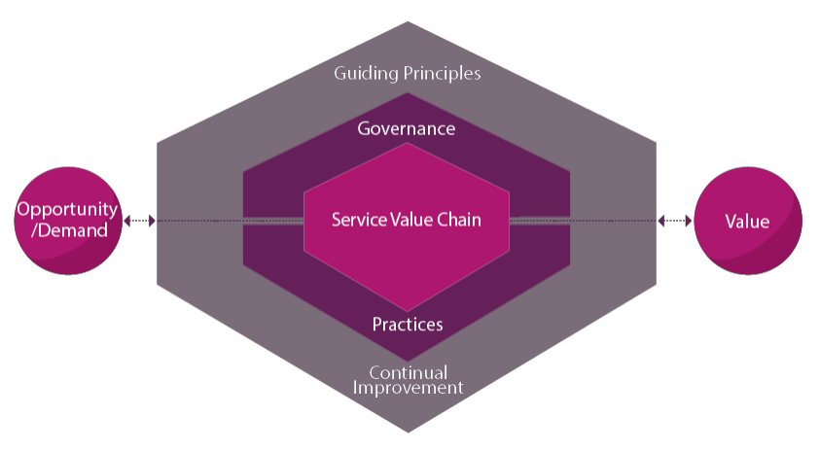
The ITIL Guiding Principles
Guiding principles guide an organization in all circumstances, regardless of changes in its goals, strategies, type of work, or management structure.
They encourage organizations in continual improvement.

Slide 11
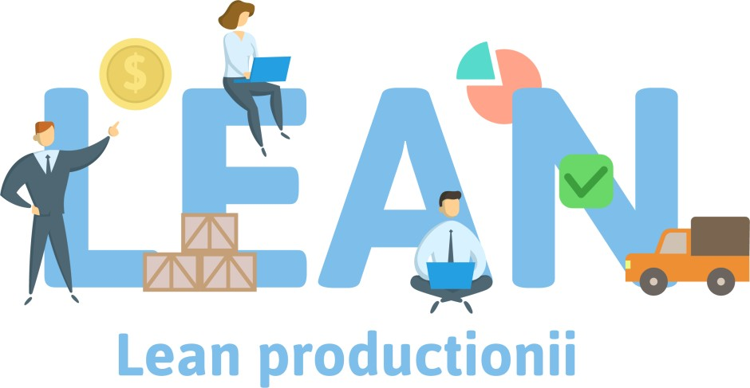
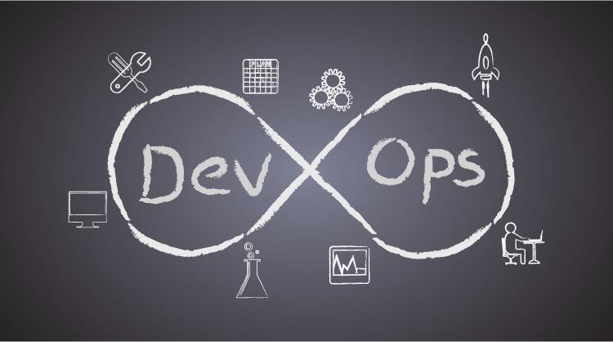
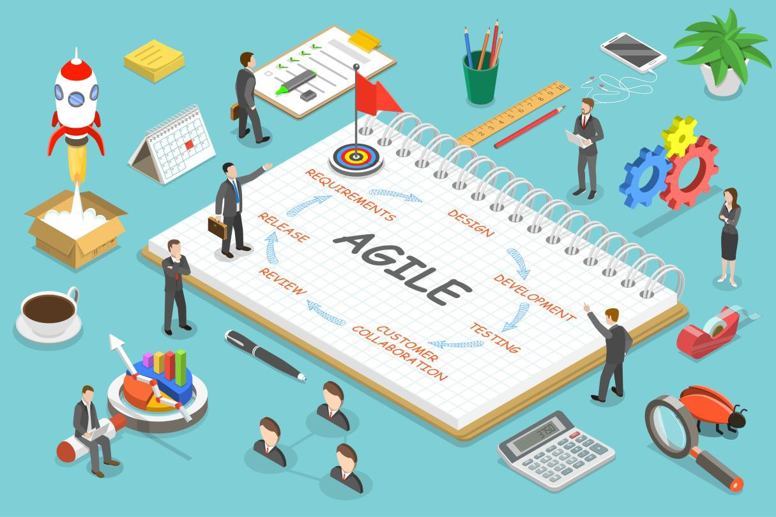
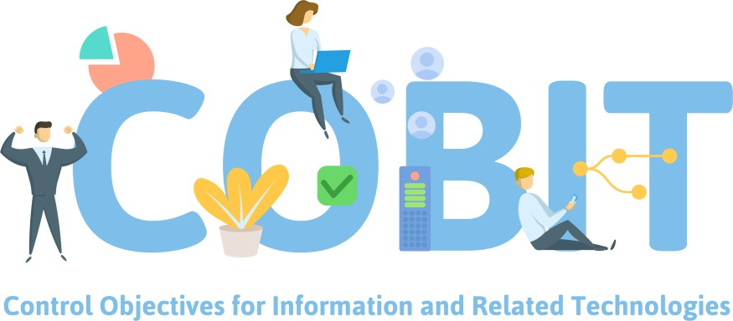
The ITIL Guiding Principles and Other Frameworks
The guiding principles are universally applicable to any initiative and to all relationships with stakeholder groups.

Slide 12

Overview of the Guiding Principles
Principle: Focus on value
Principle: Start where
you are
Principle: Progress
iteratively with feedback
Principle: Collaborate and promote visibility
Map activities to
stakeholder value.
Do not build something new without considering what is already available.
Organize work into manageable chunks and use feedback for focused actions.
Share information to the greatest degree possible.
01
02
03
04
Principle: Think and work holistically
Principle: Keep it simple and practical
Principle: Optimize and
automate
Work on the service as a whole, not just on its parts.
Use outcome-based thinking to achieve the result.
Eliminate anything that is truly wasteful and use technology to achieve results.
06
07

Slide 13

Guiding Principle: Focus on Value
Principle 01
Everything the organization does should link back to value for itself, its customers, and other stakeholders.
User
Sponsor
Consumer

Slide 14

Consumer’s Perspectives of Value
Principle 01
Why do the consumers use the services?
What does the services help them to do?
How do the services help them achieve their goals?
What are the financial consequences for the
service consumer?
What are the risks involved for the service consumer?
Perspective

Slide 15

The Customer Experience
Principle 01
Customer experience determines a customer’s view of the organization and its products and
services.

Slide 16

Varying Customer Experience
Principle 01
When a customer receives a product at the promised price and time, his experience is objectively measurable.
However, an individual customer’s opinion of the website layout from where he ordered may vary from other customers.

Slide 17



Applying the Principle
Principle 01
Keep these four tips in mind before applying the principle “focus on value.”
01
Know how service consumers use each service.
Encourage a focus on value among all staff.
02
03
Focus on value during normal operational activity as well as during improvement initiatives.
04
Focus on the value in every step of any improvement initiative.

Slide 18

Guiding Principle: Start Where You Are
Principle 02
It is not necessary to remove older technology or service in the process of creating something better.
Understand where the services and methods currently are and consider reusing them.
Getting data from the source helps to avoid assumptions that can have a negative impact on the budget and timeline.
Assess where you are

Slide 19

Role of Measurement
Principle 02
Measurement should be used to support the analysis of what has been observed.
A service desk that is measured based on the time spent on the phone may focus more on minimizing customer engagement instead of resolving the issue. Metrics need to be meaningful and directly relate to the desired outcome.

Slide 20
Applying the principle
Principle 02
Keep these four tips in mind before applying the principle “start where you are.”
Look
Determine
Apply
Recognize
Look at what exists as objectively as possible.
Determine if and how these can be replicated to achieve the desired state.
Apply your risk management skills.
Recognize that sometimes nothing from the current state can be reused.

Slide 21
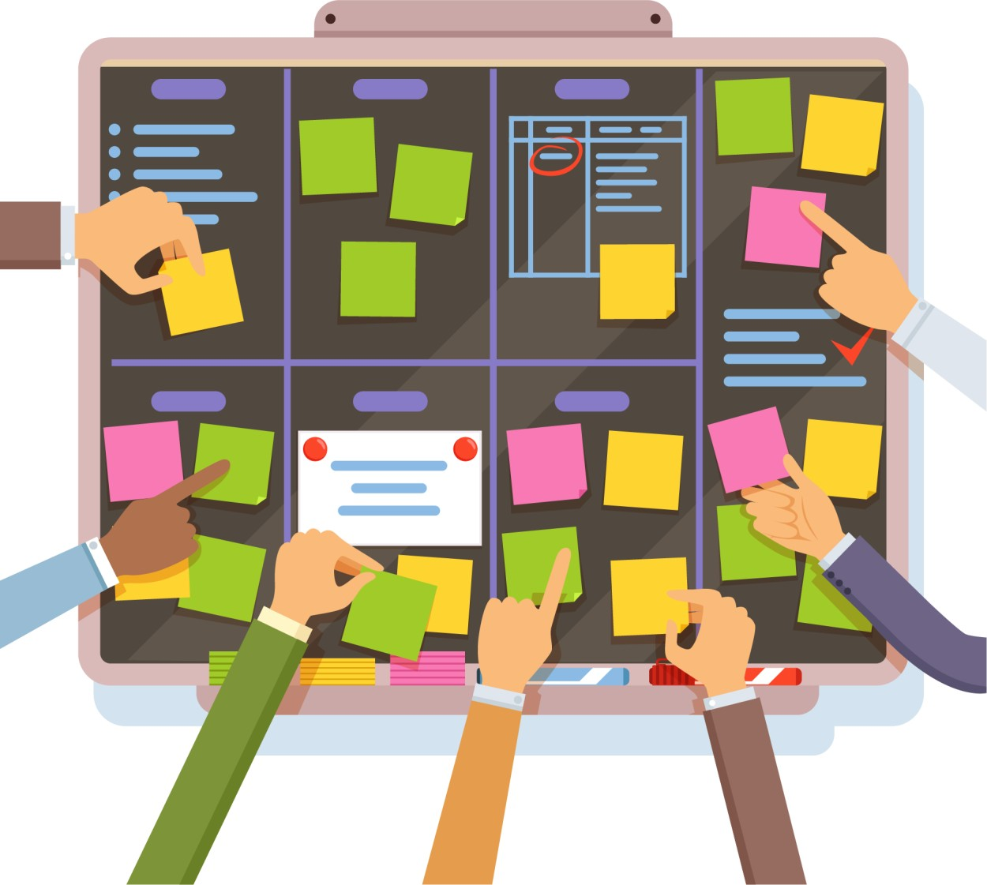
Guiding Principle: Progress Iteratively with Feedback
Principle 03
Improvement iterations can be sequential
or simultaneous.
Individual iterations should be both manageable and managed.
While the iteration is being undertaken, its
need may be altered or even eliminated.
Seeking and using feedback before, throughout, and after each iteration will ensure that actions are focused and appropriate.

Slide 22

The Role of Feedback
Principle 03
Well-constructed feedback mechanisms facilitate understanding of the:
End user and customer perception of
the value created
Efficiency and effectiveness of value chain activities
Effectiveness of service governance
and management controls
Interfaces between the organization
and its partner and the supplier network
Demand for products and services

Slide 23
Iteration with Feedback
Principle 03
Working in a time boxed, iterative manner with feedback loops embedded into the process allows for greater flexibility, faster responses, and an overall improvement in quality.

Slide 24

Applying the Principle
Principle 03
Keep these three tips in mind before applying the principle “progress iteratively with feedback.”
Understanding the big picture is important, but so is making progress, so avoid analysis paralysis.
The ecosystem is constantly changing; so
feedback is essential.
Any iteration should be produced in line with the concept of the minimum viable product.

Slide 25
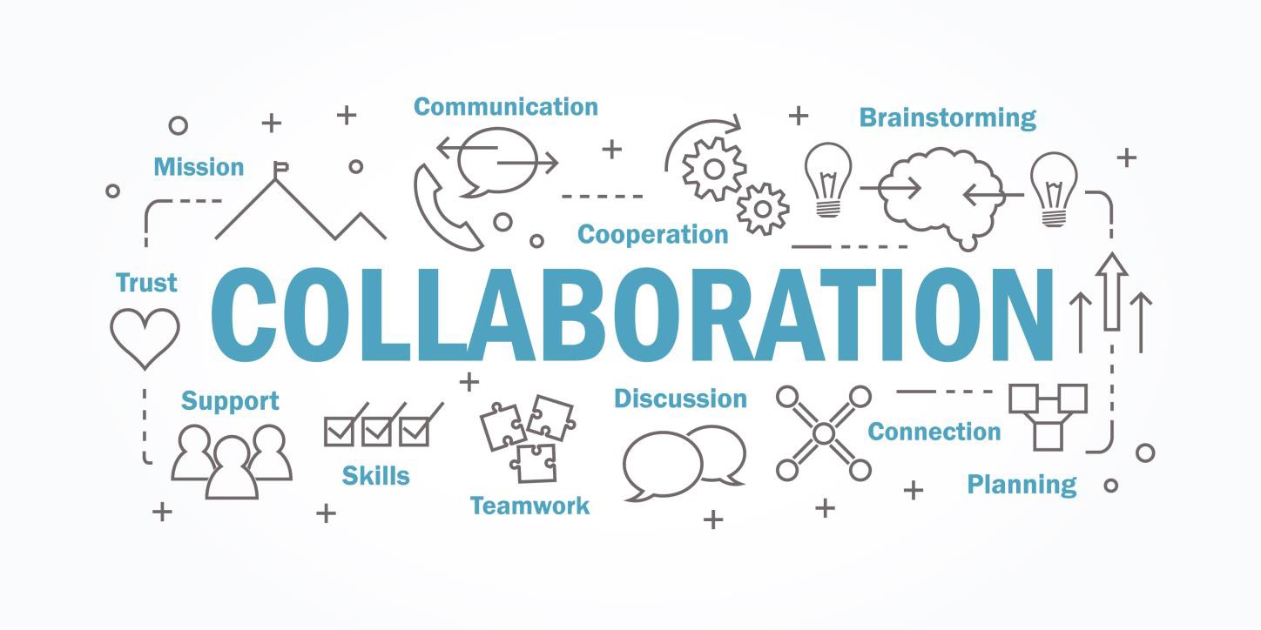
Guiding Principle: Collaborate and Promote Visibility
Principle 04
Without effective collaboration, Agile, Lean, and other ITSM frameworks or methods will not work.
Identifying and managing all the stakeholder groups that an organization deals with is important.

Slide 26
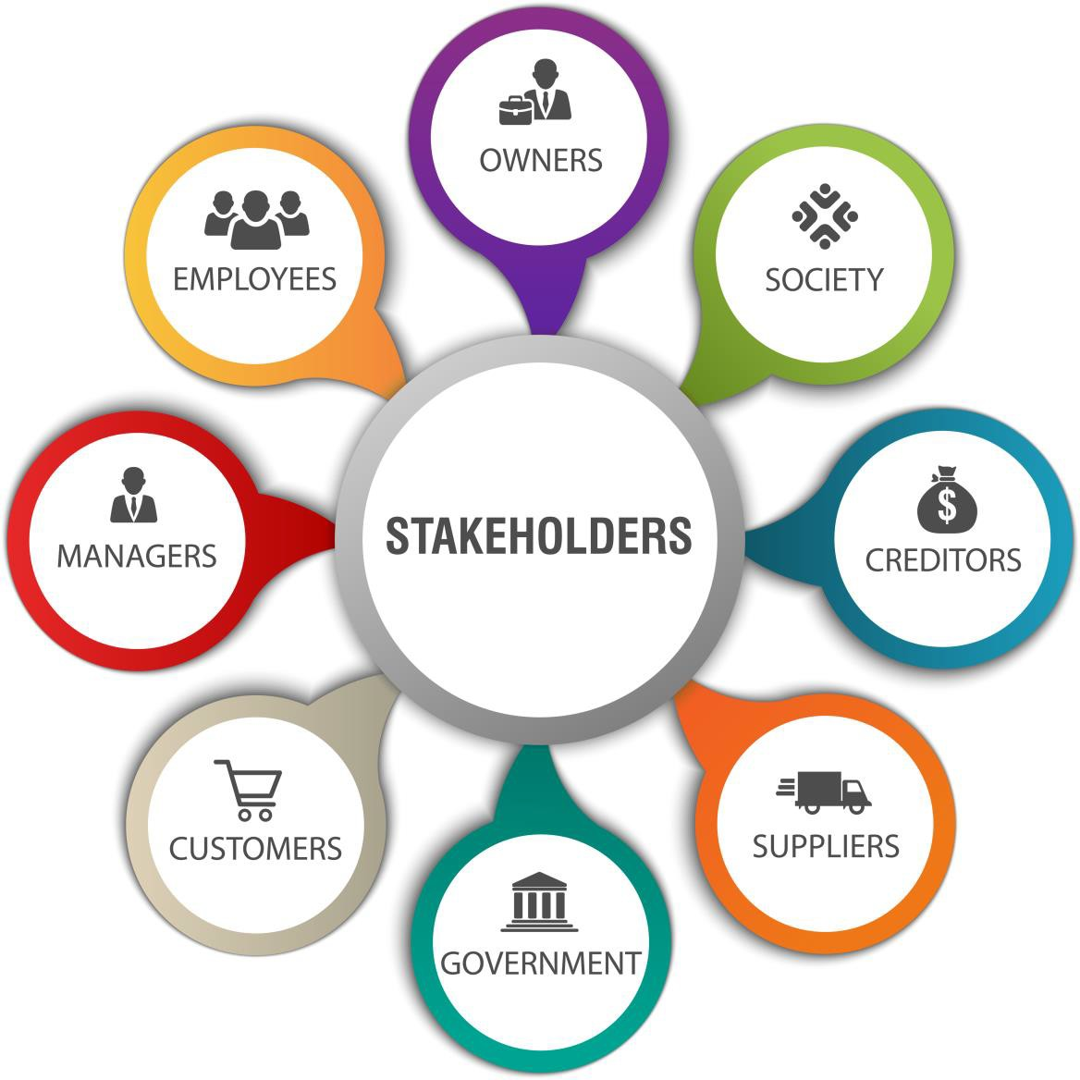
Stakeholder Collaboration
Principle 04
A stakeholder is anyone who has a stake in the activities of the organization.
Stakeholder collaboration include:
Developers working with other internal
teams
Suppliers collaborating with the organization
Relationship managers collaborating with
service consumers
Customers collaborating with each other
Internal and external suppliers collaborating
with each other

Slide 27


Increasing Urgency through Visibility
Principle 04
Insufficient visibility of work leads to poor decision-making and impacts the organization’s ability to
improve internal capabilities.
Understand the flow
of work in progress
01
Identify bottlenecks and excess capacity
02
03
Uncover
waste

Slide 28


Applying the Principle
Principle 04
Keep these three tips in mind before applying the principle “collaborate and promote visibility.”
Collaboration does not mean
consensus.
01
Communicate in a way the audience can hear.
02
Decisions can only be made
on visible data.
03

Slide 29

Guiding Principle: Think and Work Holistically
Principle 05
Taking a holistic approach to service management includes establishing an understanding of how all the parts of an organization work together in an integrated way.

Slide 30

Applying the Principle
Principle 05
Keep these four tips in mind before applying the principle “think and work holistically.”
Remember that collaboration is key to thinking and working holistically.
Recognize the complexity of the systems.
01
02
Look for patterns in the needs of and interactions between system elements.
03
Remember that automation can facilitate working holistically.
04

Slide 31

Guiding Principle: Keep It Simple and Practical
Principle 06
Use the minimum number of steps to accomplish an objective.
Ensure that your actions contribute to
value creation.
Start with an uncomplicated approach and then carefully add controls, activities, or metrics when needed.
Be mindful of conflicting objectives.

Slide 32
Applying the Principle
Principle 06
Keep these tips in mind before applying the principle “keep it simple and practical.”
01
Every activity should
create value.
Simplification is highly
effective.
02
It is better to minimize activities to focus on the quality of the actions.
Complicated and bureaucratic processes waste the time of the people involved.
03
04
05
Simple practices are easier to understand and follow.
Quick wins allow organizations to demonstrate progress and manage stakeholder
expectations.
06

Slide 33






Guiding Principle: Optimize and Automate
Principle 07
The path to optimization follows these high-level steps.
Understand and agree to the context in which the proposed optimization exists.
Assess the current state of the proposed optimization.
Agree to what the future state and priorities of the organization should be.
Ensure the optimization has the appropriate level of stakeholder
engagement and commitment.
Continually monitor the impact of optimization.
Execute the improvements in an iterative way.

Slide 34
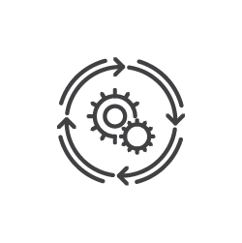
Applying the Principle
Principle 07
Keep these tips in mind before applying the principle “optimize and automate.”
Simplify and/or optimize before automating.
Define your metrics.
Use the other guiding principles when applying this one.

Slide 35

Interaction of the Guiding Principles
Ensure that they interact with and depend upon each other.
Make use of appropriate feedback as that is key to collaboration and focusing on what will truly be.
Consider the relevance of each of them and how
they apply together.

Slide 36
The ITIL® Service Value System
Topic 4: Governance

Slide 37
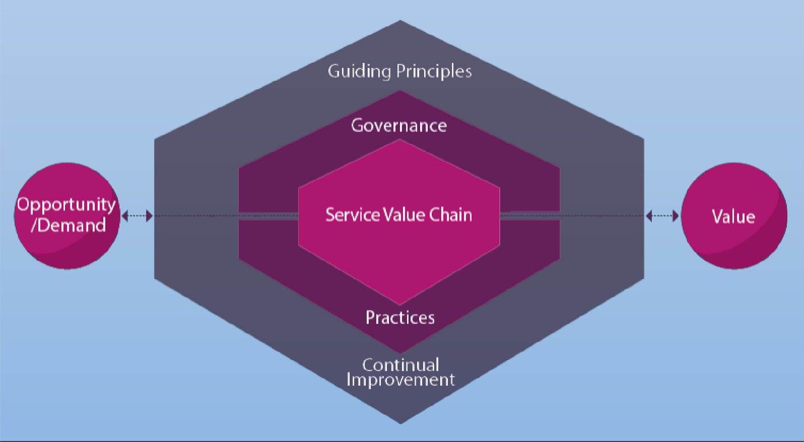
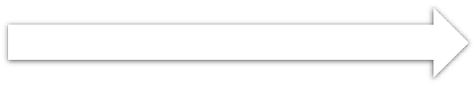
Governance
The means by which an organization is directed and controlled

Slide 38
Governance Activities
Governance is realized through the following activities:
Evaluate
Direct
Monitor
The governing body evaluates the organization on a regular basis as stakeholders’ needs and external circumstances evolve.
The governing body assigns responsibility for, and directs the preparation and implementation of, organizational strategy and policies.
The governing body monitors the performance of the organization and its practices, products, and services.

Slide 39

SVS Governance
The governing body needs to make sure that:
The service value chain and the organization’s practices work in line with the direction given by the governing body.
The governing body of the organization maintains oversight of the SVS.
Both the governing body and management at all levels maintain alignment through a clear set of shared principles and objectives.
The governance and management at all levels are continually improved to meet expectations of the stakeholders.

Slide 40
The ITIL® Service Value System
Topic 5: Service Value Chain

Slide 41

Service Value Chain
A set of interconnected activities that an organization performs to deliver a valuable product or service to its consumers and to facilitate value realization

Slide 42
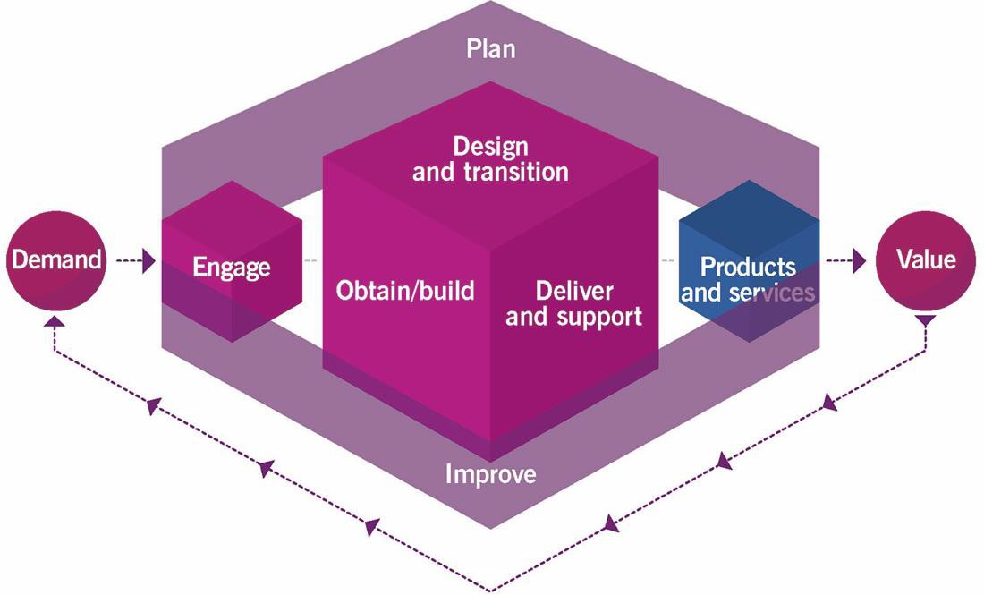
SVS Activities
The service value chain outlines the six key activities required to respond to demand and facilitate value realization through the creation and management of products and services.

Slide 43
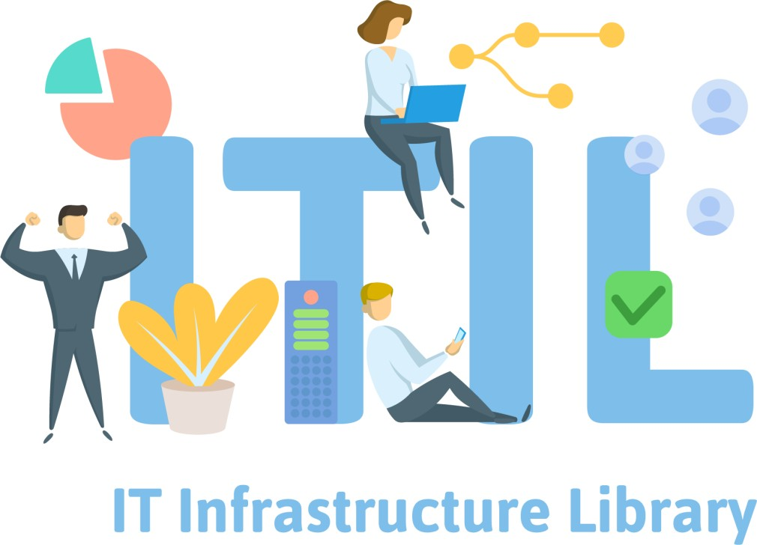
Service Value Stream
To convert inputs into outputs, the value chain activities use different combinations of ITIL practices.
To carry out a certain task, or respond to a particular situation, organizations create service value streams.
Service value streams are specific combinations of activities and practices, and each one is designed for a particular scenario.

Slide 44
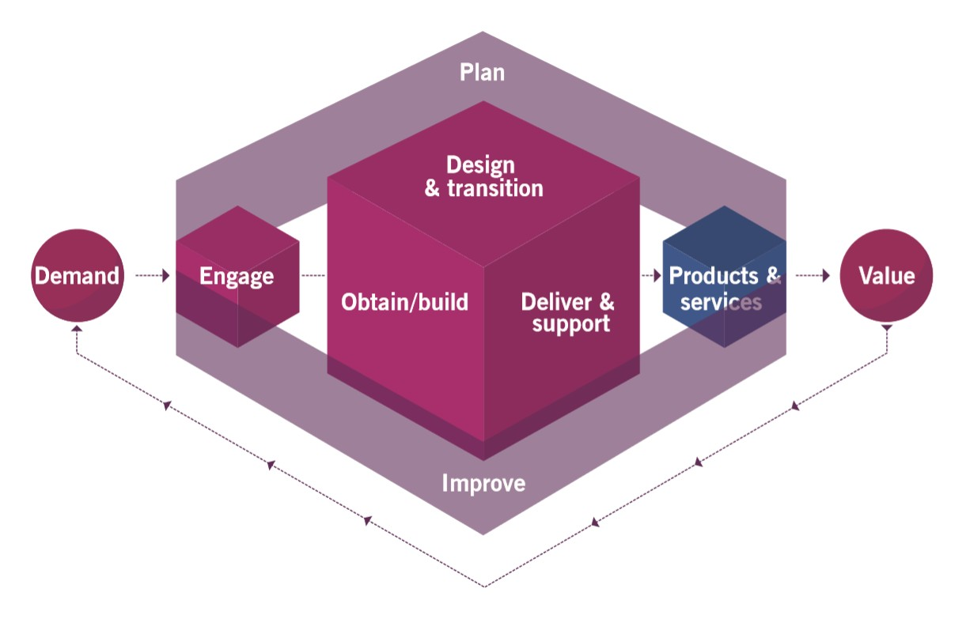
Activity 1: Plan
Plan value chain activity ensures a shared understanding of the vision, current status, and improvement direction for four dimensions and all products and services across the organization.

Slide 45







Plan: Input
Policies, requirements, and constraints
Consolidated demands and opportunities
1
2
Value chain performance information,
improvement initiatives, and plans
3
4
Improvement status reports
Knowledge and information about new and
changed products and services
5
6
Knowledge and information about third-party service
components

Slide 46







Plan: Output
Strategic, tactical, and operational
plans
1
Portfolio decisions for design and
transition
2
Architectures and policies for design and
transition
3
Improvement opportunities for
improve
4
Product and service portfolio for
engage
Contract and agreement requirements for
engage
5
6

Slide 47
Activity 2: Improve
Improve value chain activity ensures continual improvement of products, services, and
practices across all value chain activities and the four dimensions of service management.

Slide 48




Improve: Input
Product and service performance information
1
Stakeholders’
feedback
2
Performance information and improvement opportunities
3
4
Knowledge and information about new and changed products and services
5
Knowledge and information about third-party service
components

Slide 49





Improve: Output
Improvement initiatives and plans for all value chain activities
1
Value chain performance information for plan and the governing body
2
Improvement status reports for all value chain
activities
3
Service performance information for design and transition
4

Slide 50
Activity 3: Engage
This activity provides a good understanding of stakeholder needs and continual
engagement, transparency, and good relationships with all stakeholders.

Slide 51

Engage: Input
Product and service portfolio provided by plan
Requests and feedback from customers
High-level demand for services and products provided by
internal and external customers
Detailed requirements for services and products provided by customers
Knowledge and information about third-party service components from suppliers and partners
Incidents, service requests, and feedback from users
Improvement status reports from improve

Slide 52
Engage: Input
Information on the completion of user support tasks from deliver and support
Market opportunities from current and potential customers and users
Cooperation opportunities and feedback provided by partners and suppliers
Contract and agreement requirements from all value chain
activities
Knowledge and information about new and changed products and services from design and transition and obtain/build
Product and service performance information from deliver and
support
Improvements initiatives and plans from improve

Slide 53

Engage: Output
Consolidated demands and opportunities for plan
Product and service requirements for design and transition
User support tasks for deliver and support
Improvement opportunities and stakeholders’ feedback for
improve
Change or project initiation requests for obtain/build
Contracts and agreements with external and internal suppliers
and partners for obtain/build and design and transition
Knowledge and information about third-party service components for all value chain activities
Service performance reports for customers

Slide 54
Activity 4: Design and Transition
This activity ensures that products and services continually meet stakeholder expectations
for quality, costs, and time to market.

Slide 55
Design and Transition: Input
Portfolio decisions provided by plan
Architectures and policies provided by plan
Product and service requirements provided by engage
Improvement initiatives and plans provided by improve
Service performance information provided by deliver and support and improve
Service components from obtain/build
Knowledge and information about third-party service components from engage
Knowledge and information about new and changed
products and services from obtain/build

Slide 56
Design and Transition: Output
Requirements and specifications for
obtain/build
Contract and agreement requirements for engage
New and changed products and services for deliver and support
Knowledge and information about new and changed products and services to all value chain activities
Performance information and
improvement opportunities for improve

Slide 57
Activity 5: Obtain/Build
This activity ensures that the service components are available when and where they are needed and meet agreed specifications.

Slide 58
Obtain/Build: Input
Architectures and policies provided by plan
Contracts and agreements with external and internal suppliers and partners provided by engage
Goods and services provided by external and internal
suppliers and partners
Requirements and specifications provided by design and transition
Improvement initiatives and plans provided
by improve
Improvement status reports from improve
Change or project initiation requests provided by engage
Change requests provided by deliver and support
Knowledge and information about new and changed
products and services from design and transition
Knowledge and information about third-party service components from engage

Slide 59
Obtain/Build: Output
Service components for deliver and support
Service components for design and transition
Knowledge and information about new and changed service components to all value chain activities
Contract and agreement requirements
for engage
Performance information and improvement opportunities for improve

Slide 60
Activity 6: Deliver and Support
This activity ensures that services are delivered and supported according to agreed
specifications and stakeholders’ expectations.

Slide 61
Deliver and Support: Input
New and changed products and services provided by design and transition
Contracts and agreements with external and internal
suppliers and partners provided by engage
Service components provided by obtain/build
Improvement initiatives and plans provided by improve
Improvement status reports from improve
User support tasks provided by engage
Knowledge and information about new and changed service components and services from design and transition and obtain/build
Knowledge and information about third-party service
components from engage

Slide 62
Deliver and Support: Output
Services delivered to customers and users
Information on the completion of user
support tasks for engage
Product and service performance information for engage and improve
Improvement opportunities for improve
Contract and agreement requirements for engage
Change requests for obtain/build
Service performance information for design and transition

Slide 63
The ITIL® Service Value System
Topic 6: Continual Improvement

Slide 64
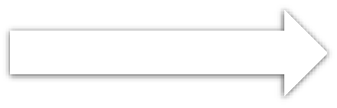
Continual Improvement
A recurring organizational activity performed at all levels to ensure that an organization’s performance continually meets stakeholders’ expectations

Slide 65
Continual Improvement
The ITIL continual improvement model can be used as a high-level guide to support improvement initiatives.
The model puts a strong focus on customer value and ensures that improvement efforts can be linked back to the organization’s vision.
It also supports an iterative approach to improvement, dividing work into manageable pieces with separate goals that can be achieved incrementally.

Slide 66
ITIL SVS Support
To support continual improvement at all levels, the ITIL SVS includes:
The continual improvement practice
The continual improvement model
The improve service value chain activity

Slide 67
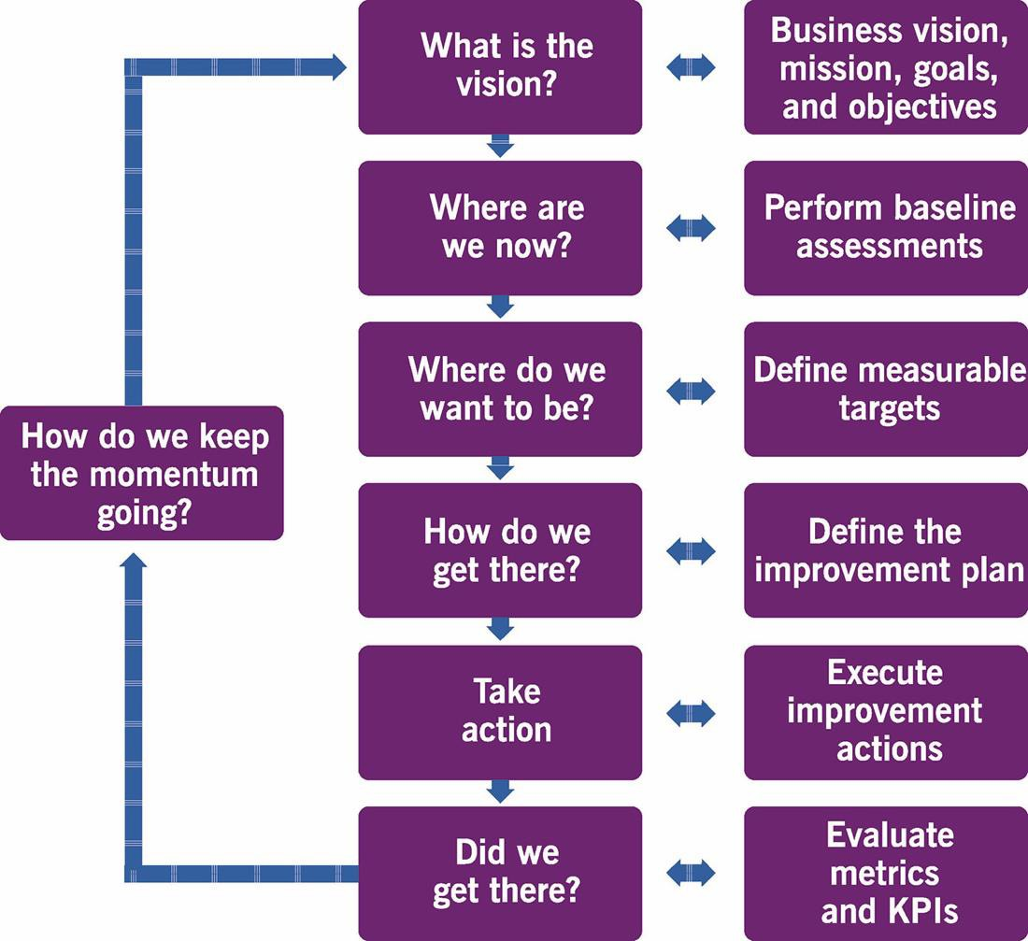
Continual Improvement Model

Slide 68







Continual Improvement Model: Steps
Principle 07
Step 1: What is the vision?
Step 2: Where are we now?
Step 3: Where do we want to be?
Step 4: How do we get there?
Step 5: Take action
Step 6: Did we get there?
Step 7: How do we keep the momentum going?

Slide 69
Siloed Organizations
Organizational silos are a challenge to organizations.
Organizational silos happen when there is:
Siloed organizations:
Cannot act quickly to take advantage of opportunities or to optimize the use of resources across the organization
Are unable to make effective decisions about changes
Can cause practices to become silos
Resistance to change
Difficulty in accessing information and specialized expertise
Reduced efficiency that increases both cost and risk
Difficulty in communication or collaboration

Slide 70

Addressing the Challenge of Silos
The architecture of the ITIL SVS enables flexibility and discourages siloed working.
The service value chain activities and practices can be combined in multiple value streams to address the needs of the organization in a variety of scenarios.

Slide 71
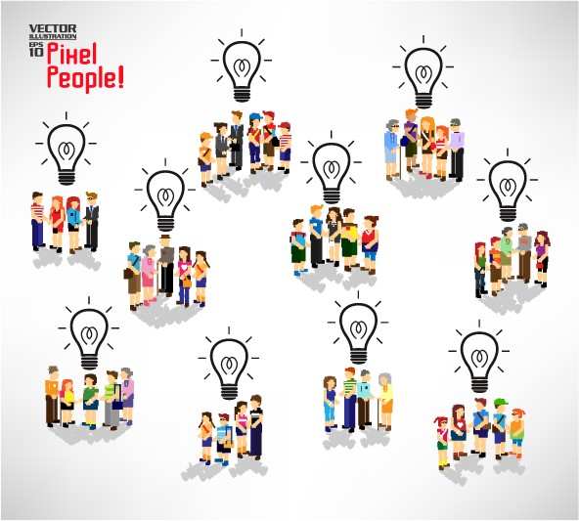
Addressing the Challenge of Silos
Organizations should be able to define and redefine their value streams in a flexible, yet safe and efficient manner.
The ITIL guiding principles guide the overall improvement of the organization.
The guiding principles create a foundation for a shared culture across the organization that discourages silos.

Slide 72

Organizational Agility and Organizational Resilience
Organizational agility is the ability of an organization to move and adapt quickly, flexibly, and decisively to support internal changes.
Organizational resilience is the ability of an organization to anticipate, prepare for, respond to, and adapt to both incremental changes and sudden disruptions from an external perspective.

Slide 73
Organizational Agility and Organizational Resilience
The ITIL SVS provides the means to achieve organizational agility and resilience.
Changes to the scope of the organization, mergers and acquisitions, changing organizational practices
Resilience cannot be achieved without a
common understanding of the
organization’s priorities and objectives.
Changes to the technologies requiring different skills
Changes to the organizational structure and
relationships with partners and suppliers
Changes in the external influences that can be political, economic, social, technological, legal or environmental

Slide 74
The ITIL® Service Value System
Topic 7: Agile ITSM

Slide 75
ITIL, Agile, and DevOps
Agile is a methodology that focuses on delivery and evolution of requirements from small teams.
Agile teams can work more effectively to enable faster and more stable deployment to the live environment.
Agile shares many common themes with ITIL.
DevOps centers on the process of delivering software to live environments, with a focus on unifying technical operations and delivery.

Slide 76

Agile Roles
Product managers/owners can perform the role
of the service owner
Scrum masters can perform the role of the change manager
Scrum masters can be part of the wider
continual improvement practice

Slide 77
Agile Software Development
Agile development includes:
Continually evolving requirements, collected through feedback analysis and direct observation
Breaking development work into small increments and iterations
Establishing product-based cross-functional
teams
Visually presenting and regularly discussing
Presenting a working software to the
stakeholders at the end of each iteration

Slide 78

Key Takeaways
The ITIL SVS describes how all the components and activities of the organization work together as a system to enable value creation.
Each organization’s SVS has interfaces with other organizations, forming an ecosystem that facilitates value creation for the organizations, their customers, and other stakeholders.
The ITIL SVS is a powerful holistic construct for the governance and management of modern products and services and helps organizations to co-create value with consumers.
The SVS includes the service value chain activities supported by universal and holistic practices that allow the organization to manage and fulfil demands of all types.
Every organization participates in some form of the value chain activities.

Slide 79
Thank You
ITIL® 4 Foundation Certification Course
Based on AXELOS ITIL® material.
ITIL® is a [registered] trade mark of AXELOS Limited.

